Slide 1
Full Stack Development with Java and NoSQL
Nic Raboy | @nraboy

Slide 2
The Agenda
The importance of full-stack development
The different parts of the application stack
Taking control of your data with Couchbase NoSQL
Containers with Docker
Creating a RESTful API
Developing numerous front-end applications
Data synchronization

Slide 3
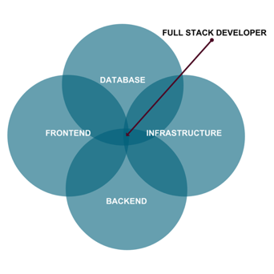
The Role of a Full-Stack Developer

Slide 4
The Breakdown of a Stack
Client Frontend
Desktop
Mobile
IoT
Backend
Web Application
Authentication
Middleware
Database

Slide 5
Our Stack
Client Frontend
JavaFX
Angular
Backend
Web Application
Sync Gateway
Couchbase

Slide 6
Angular
Cross platform applications
Web, Android, iOS (NativeScript & Ionic), Desktop (Electron)
TypeScript
Typed and heavily structured

Slide 7
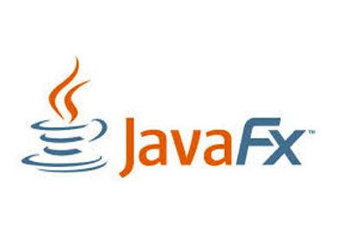
JavaFX
Java desktop applications
Familiar APIs
WYSIWYG UI editor with Scene Builder
Self contained and deployable cross-operating system

Slide 8

Java Web Application
Do you lift, bro?
Direct interaction with database
Can be accessed from many frontends

Slide 9
NoSQL Database
Easily scalable
Flexible JSON schemas
Less maintenance code
Data format matches API responses

Slide 10
Couchbase: The Complete Database Solution
Couchbase Lite
Sync Gateway
Couchbase Server
EMBEDDED DATABASE
SYNCHRONIZATION
DATABASE SERVER
Lightweight embedded NoSQL database with full CRUD and query functionality.
Secure web gateway with synchronization, REST, stream, batch and event APIs for accessing and synchronizing data over the web.
Highly scalable, highly available, high performance NoSQL database server.
SECURITY
Built-in enterprise level security throughout the entire stack includes user authentication, user and role based data access control (RBAC), secure transport (TLS), and 256-bit AES full database encryption.

Slide 11
Couchbase Lite Overview
Cross-platform support for all major operating systems and platforms
Built native from the ground up
500kb for most platforms
256-bit AES full database encryption
Couchbase Lite
Embedded Database
11

Slide 12
Sync Gateway Overview
Synchronize data between Couchbase Lite and Couchbase Server
REST, Stream, Batch, and Event APIs
Pluggable authentication
Fine grained user and role based access control
Elastically scalable in real-time
Sync Gateway
Synchronization
12

Slide 13
Couchbase Server Overview
Scale easily to thousands of nodes
Consistent high performance that supports millions of concurrent users
Flexible JSON data model
24x365 always-on availability
Couchbase Server
Database Server
13

Slide 14
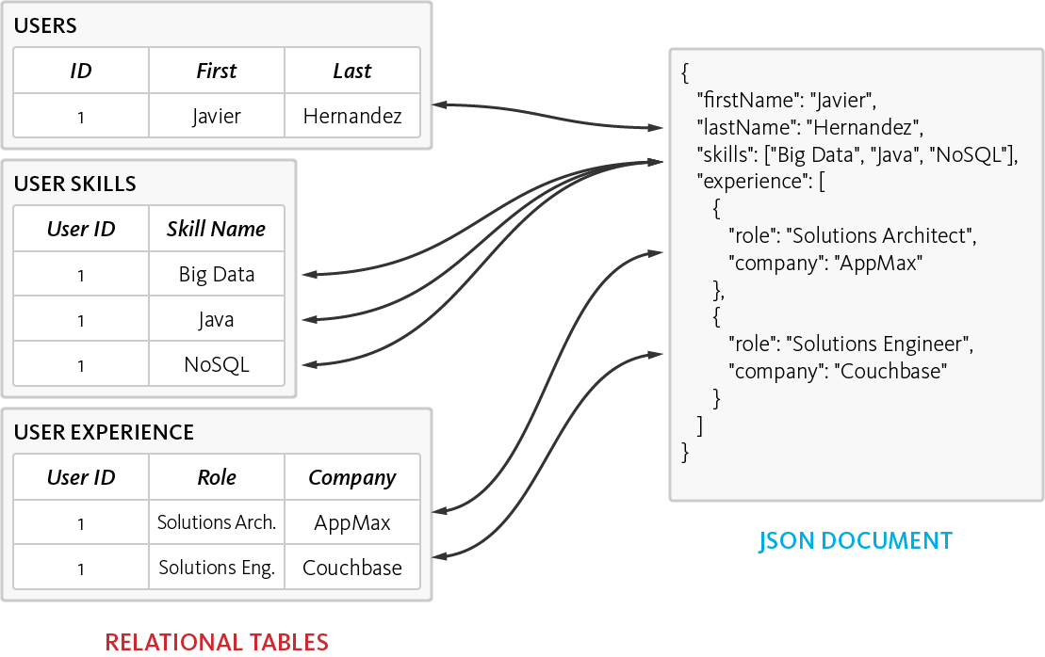
The Power of the Flexible JSON Schema
Ability to store data in multiple ways
De-normalized single document, as opposed to normalizing data across multiple table
Dynamic Schema to add new values when needed

Slide 15
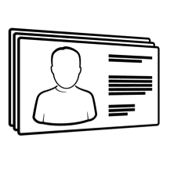
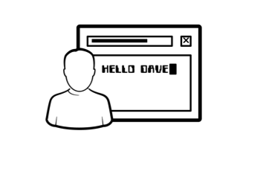
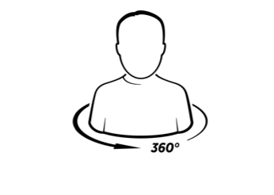
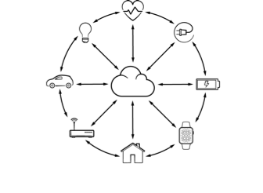
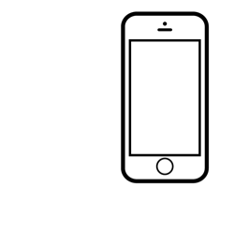
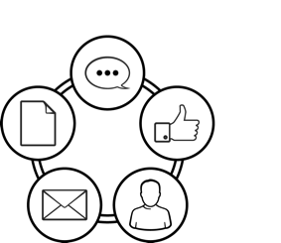
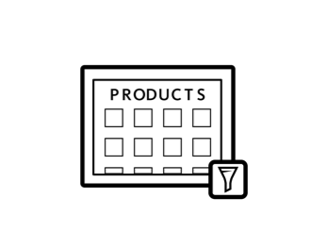
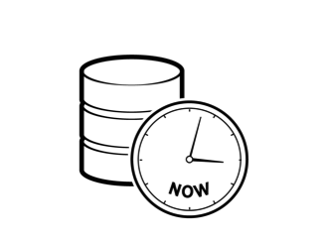

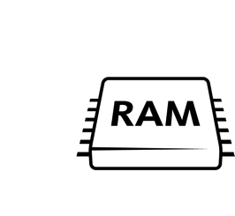
Top Use Cases
Profile Management
Personalization
360º Customer View
Internet of Things
Mobile Applications
Content Management
Catalog
Real Time Big Data
Digital Communication
High Availability Caching

Slide 16
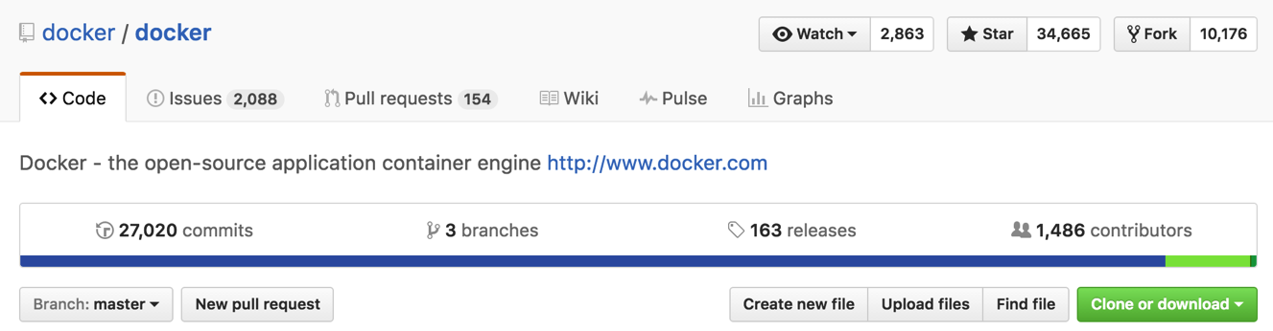
What is Docker?
Open source project and company
Used to create containers for software applications
Package Once Deploy Anywhere (PODA)

Slide 17
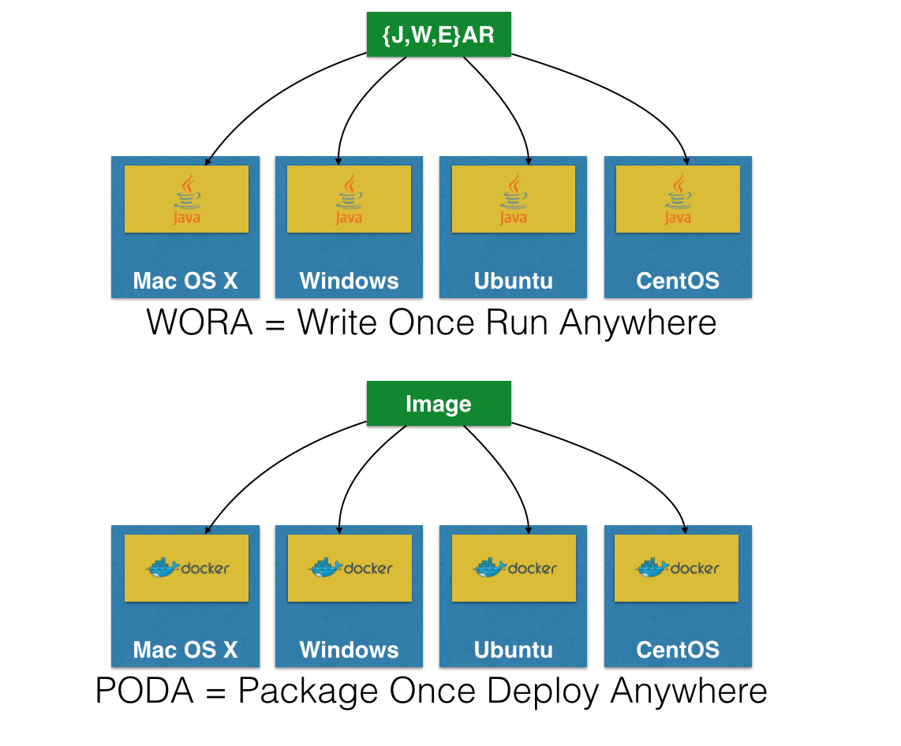

Slide 18
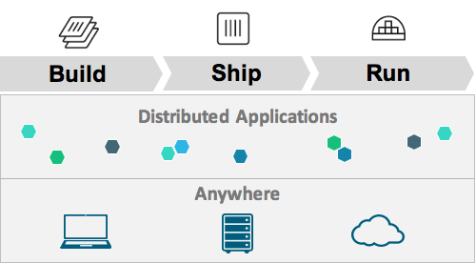
Docker Mission

Slide 19
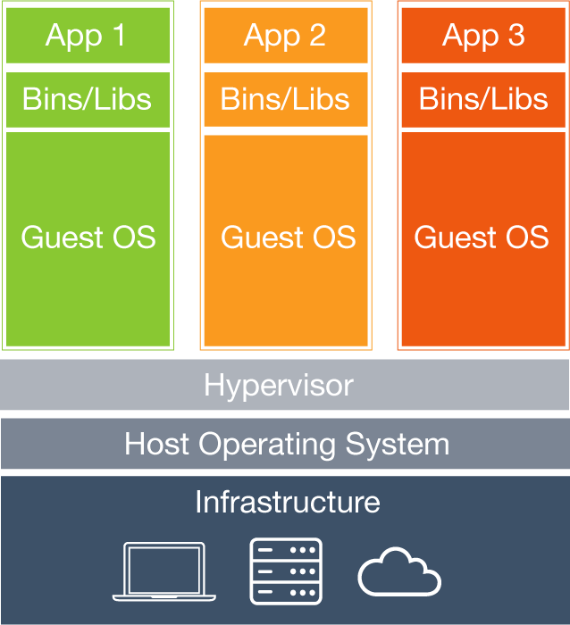
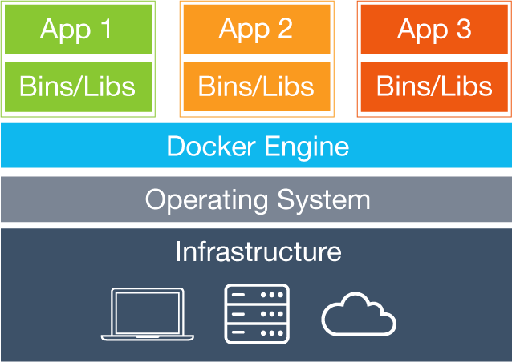
Notes:
The Docker engine as a hypervisor equivalent looks a little bloated. I.e. dockerd merely responds to client requests. It's not really a hypervisor equiv. The container runs on host kernel using kernel LXC not even the host OS. So the Host OS and Docker Engine makes it look more bloated than it is.

Slide 20
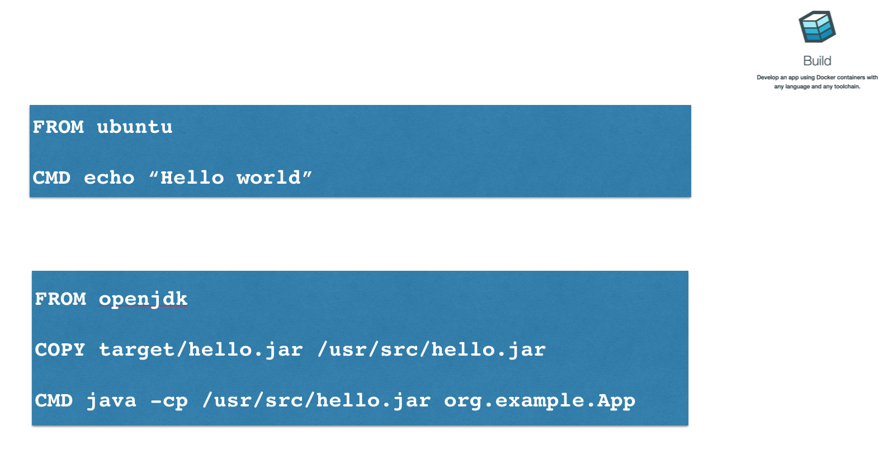

Slide 21
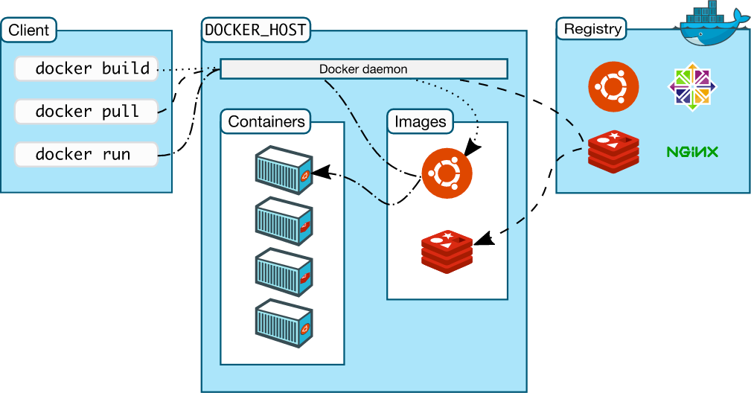


Docker Workflow

Slide 22


Docker for Mac/Windows
Native application and UI
Auto update capability
No additional software required, e.g. VirtualBox
OSX: xhyve VM using Hypervisor.framework
Windows: Hyper-V VM
Better networking and filesystem mounting/notification
Download: docker.com/getdocker
Requires Yosemite 10.10+ or Windows 10 64-bit

Slide 23
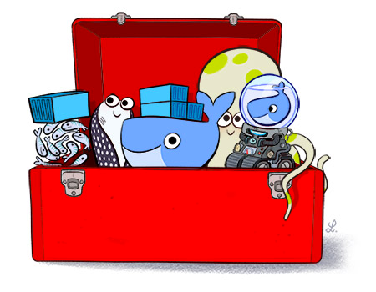
Docker Toolbox
Docker Engine
Docker Machine
Docker Compose
Docker Kitematic
Virtual box
Quickstart Terminal
https://www.docker.com/toolbox

Slide 24


Docker for AWS/Azure
Amazon Web Services
Amazon CloudFormation templates
Integrated with Autoscaling, ELB, and EBS
Azure
Integrated with VM Scale Sets for autoscaling, Azure Load Balancer, Azure Storage
beta.docker.com (restricted availability)

Slide 25
Workshop Goals
Deploy a Couchbase Cluster with Docker
Create a RESTful API with Spring Boot
Consume the RESTful API with Angular
Consume the RESTful API with JavaFX
Add synchronization support to the application

Slide 26
Workshop Material
https://github.com/couchbaselabs/devnexus-java-workshop

Slide 27
Create a Custom Container Deployment

Slide 28
Deploying a Docker Container
docker pull couchbase
docker run -d --name database -p 8091-8094:8091-8094 couchbase
http://localhost:8091

Slide 29
Managing a Docker Container
docker ps
docker logs -f database
docker stop database
docker rm database
docker rmi couchbase

Slide 30
Customizing Docker Images
Custom ‘Dockerfile’
Define base image to be used
FROM couchbase:latest
Copy files from host or execute scripts within the container after deployment
COPY localfile container_file
CMD [“command_to_run”]

Slide 31
Workshop Part #1

Slide 32
Java with Couchbase Server

Slide 33
Connecting to Couchbase

Slide 34
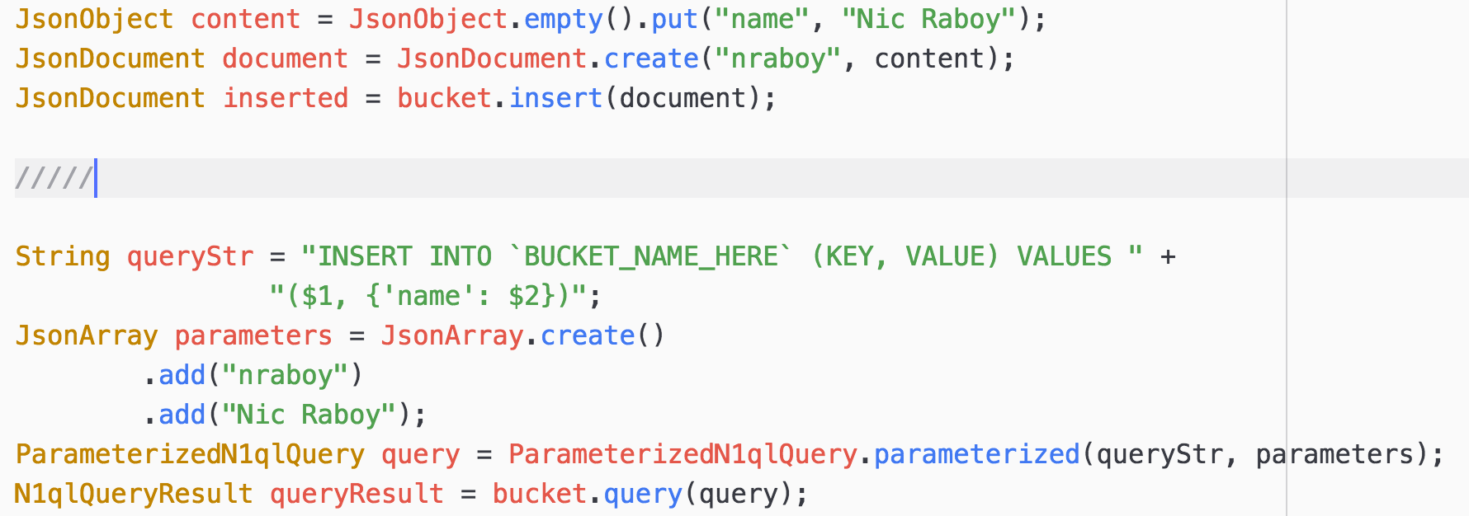
Creating NoSQL Documents

Slide 35
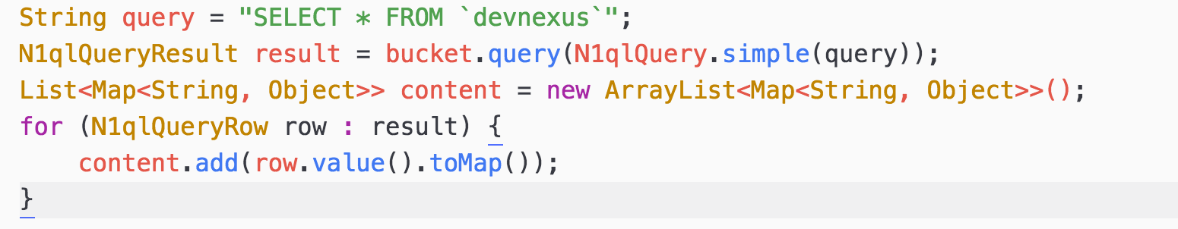
Querying with N1QL

Slide 36
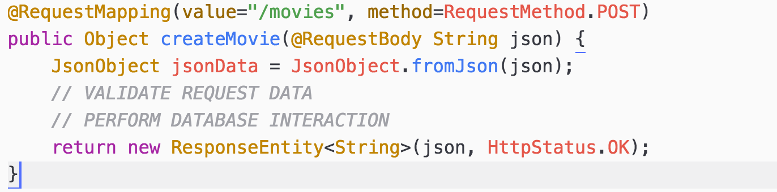
RESTful API Endpoints

Slide 37
API Endpoints
Retrieving all documents
GET /movies
Retrieving documents based on criteria
GET /search?title=
Creating new documents
POST /movies

Slide 38
Workshop Part #2

Slide 39
Building an Angular Front-End

Slide 40
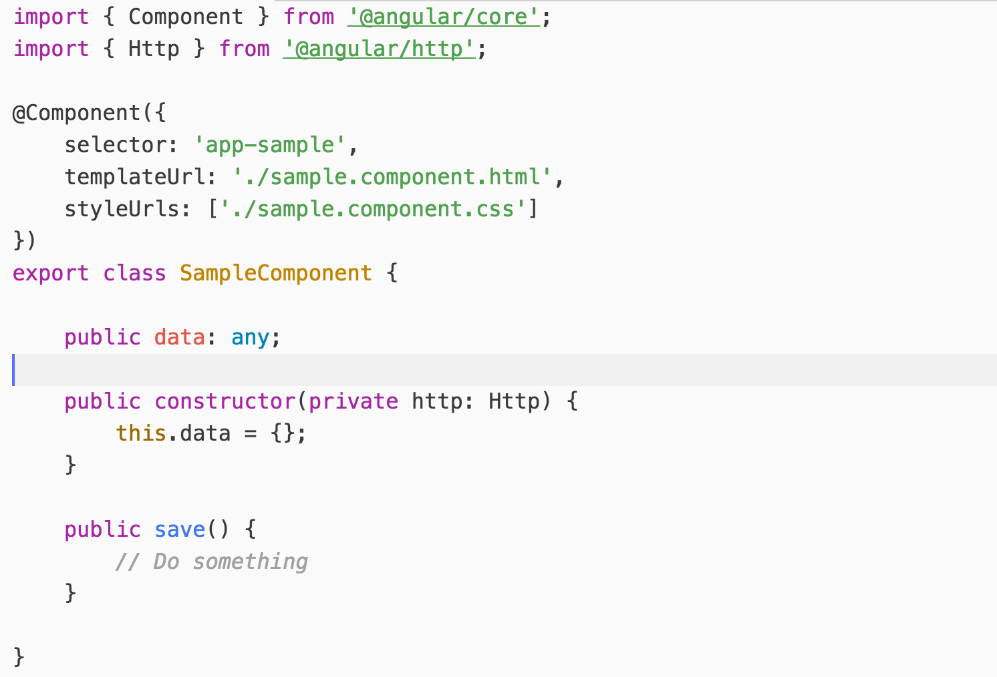
Angular Components

Slide 41
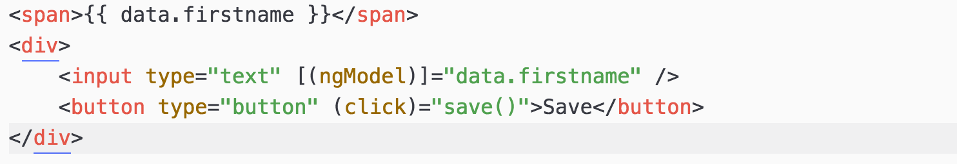
Angular HTML UI

Slide 42
Observables and RxJS
Same APIs as RxJava
Allows for asynchronous interactions
Great for HTTP requests which take variable amounts of time

Slide 43
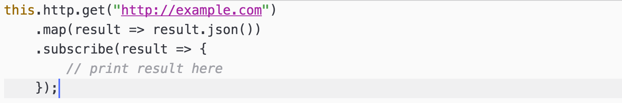
HTTP Requests Against an API

Slide 44
Workshop Part #3

Slide 45
Creating a Desktop Client with JavaFX

Slide 46
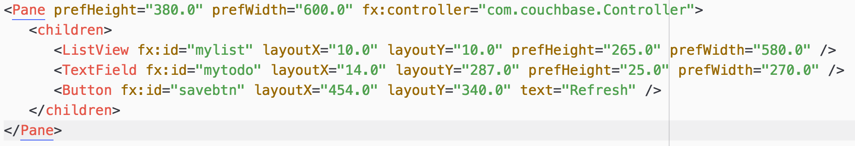
JavaFX Scenes

Slide 47
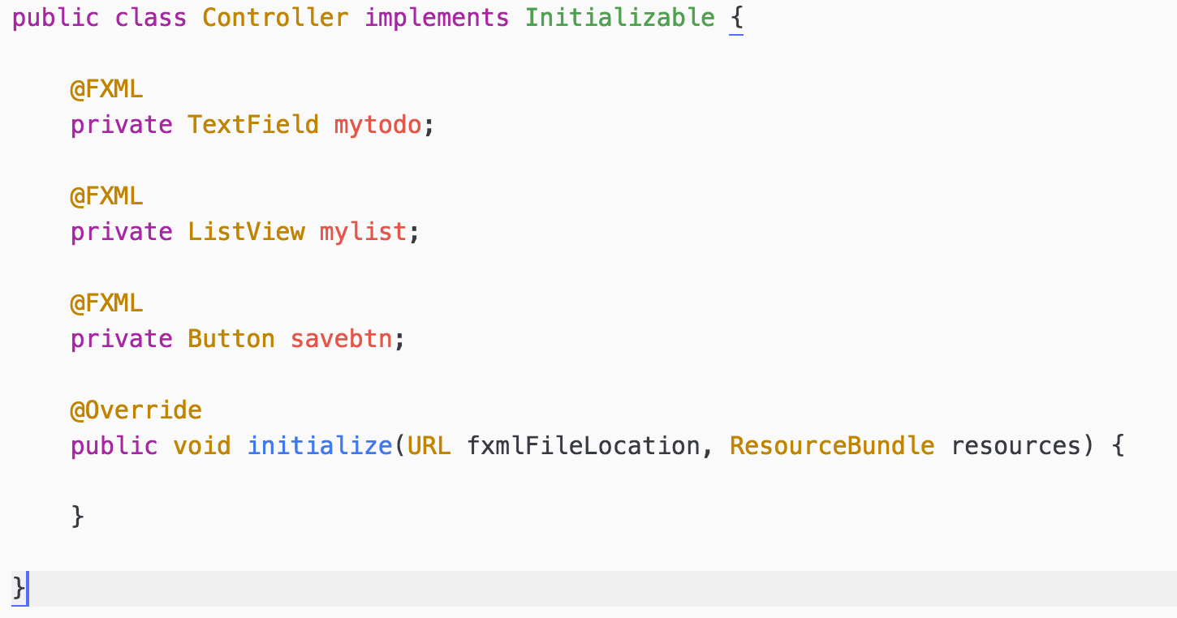
JavaFX Scene Controller

Slide 48
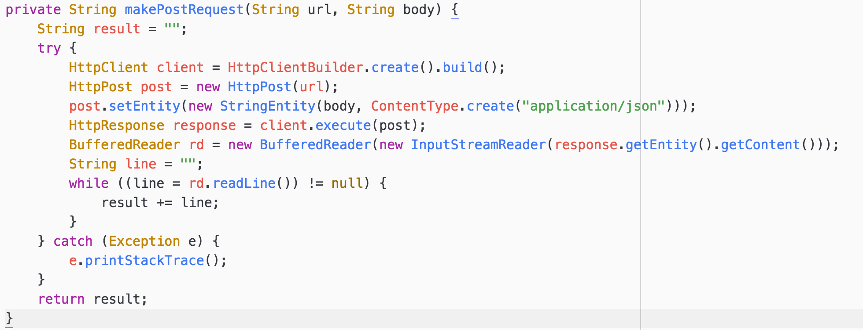
HTTP Requests in Java

Slide 49
Workshop Part #4

Slide 50
Synchronizing Instead of Requesting

Slide 51
Data Differences: Sync vs REST
Local database
Works offline
Two way replication
Data revisions

Slide 52
Local Couchbase Lite Database

Slide 53
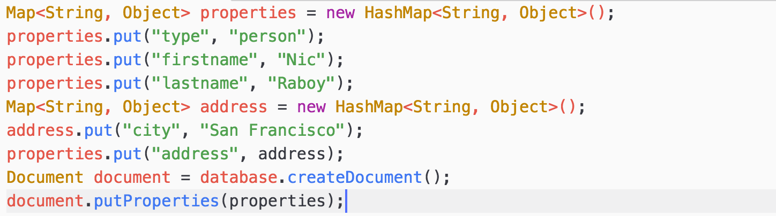
Saving a Document Locally

Slide 54
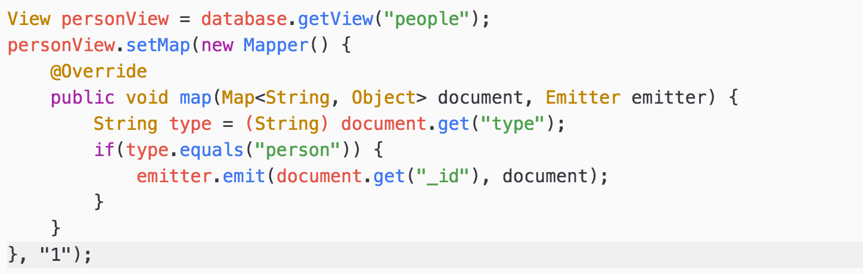
Querying MapReduce Views

Slide 55
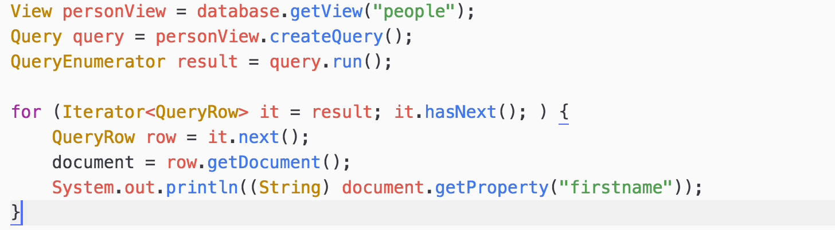
Querying MapReduce Views

Slide 56
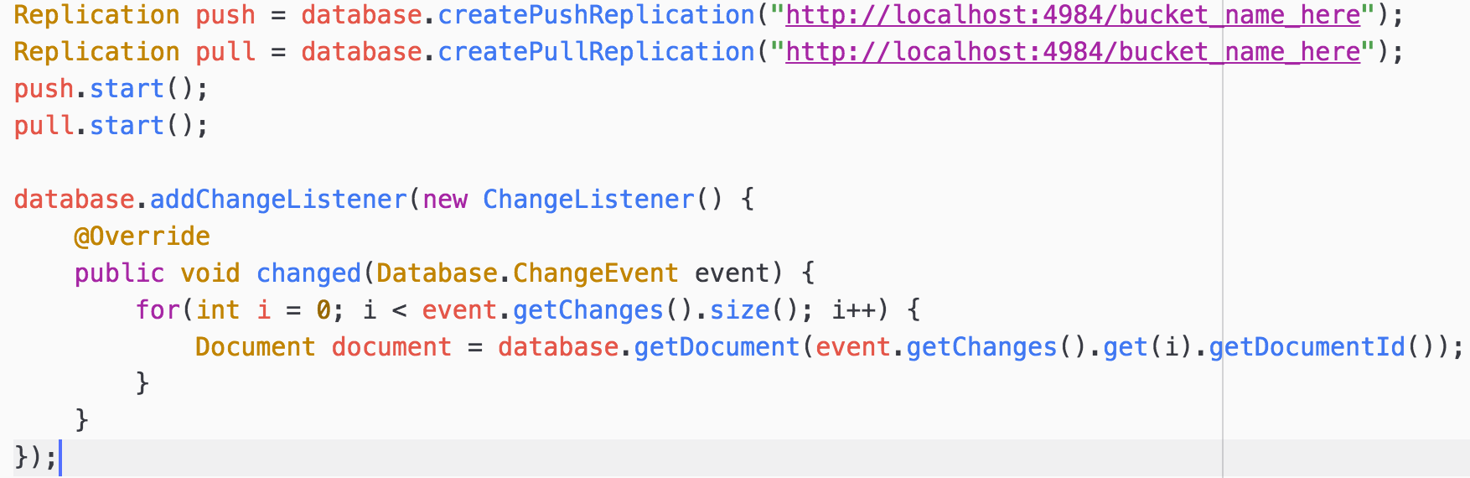
Synchronization and Listeners

Slide 57
Workshop Part #5

Slide 58
Sync and REST in One

Slide 59
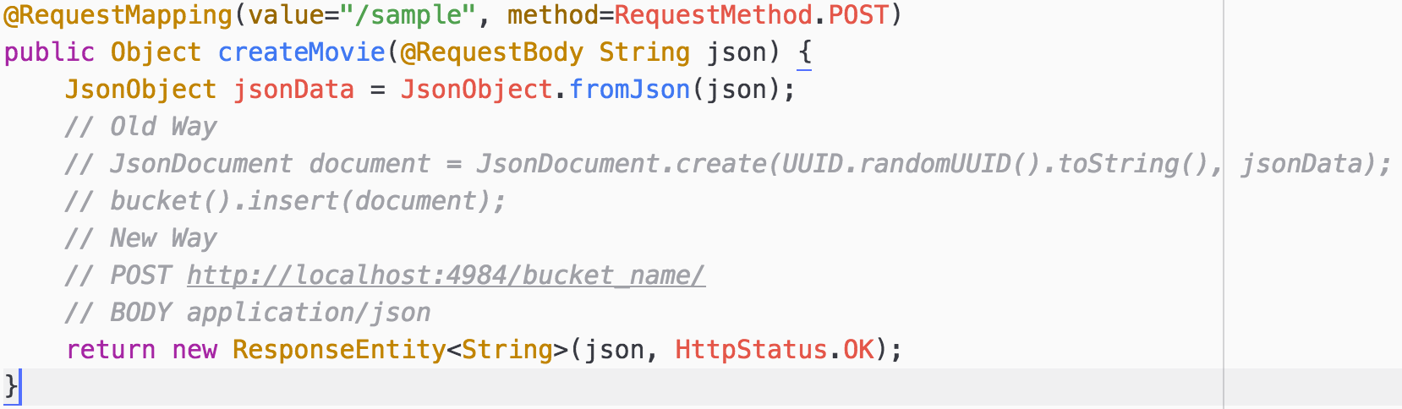
Sync Gateway REST APIs

Slide 60
Workshop Part #6

Slide 61
Project and Sample Applications
https://github.com/couchbaselabs/devnexus-java-workshop
https://github.com/couchbaselabs/try-cb-java
https://github.com/couchbaselabs/comply-java

Slide 62
Where do you find us?
developer.couchbase.com
blog.couchbase.com
@couchbase / @couchbasedev / @nraboy
forums.couchbase.com
stackoverflow.com/questions/tagged/couchbase

